Slide 1
The Benefits of Social Networking
By
Brian Cullinan
Shiqi Wang
Lun Hai

Slide 2
In this presentation
What is social networking?
Different types of social networking
The benefits of social networking over other types of media.
How to use social networking.
Concluding statements

Slide 3
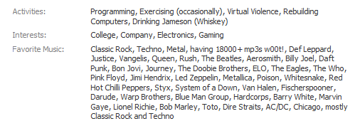
What is Social Networking?
Online communities of people who share interests and/or activities, or who are interested in exploring the interests and activities of others.
Lun
Notes:
Here are some examples

Slide 4
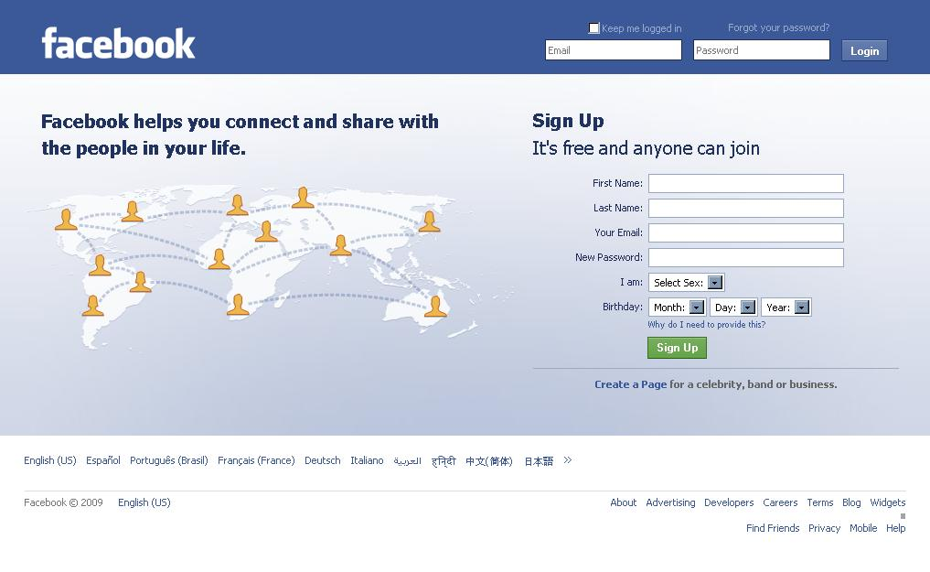
Facebook

Slide 5
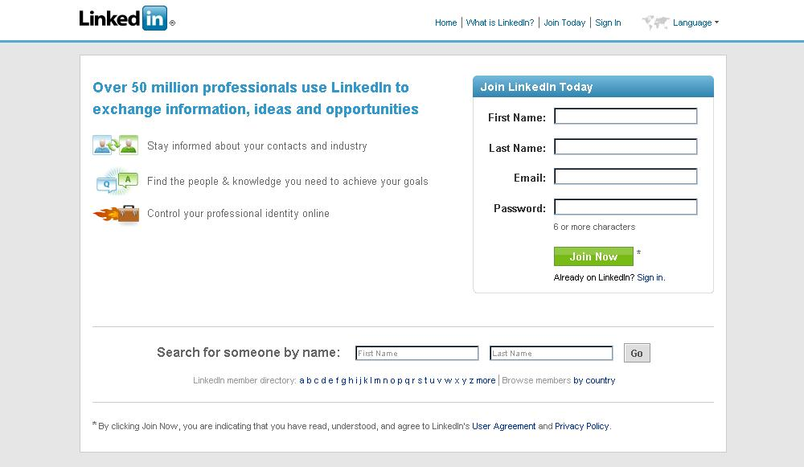
LinkedIn

Slide 6
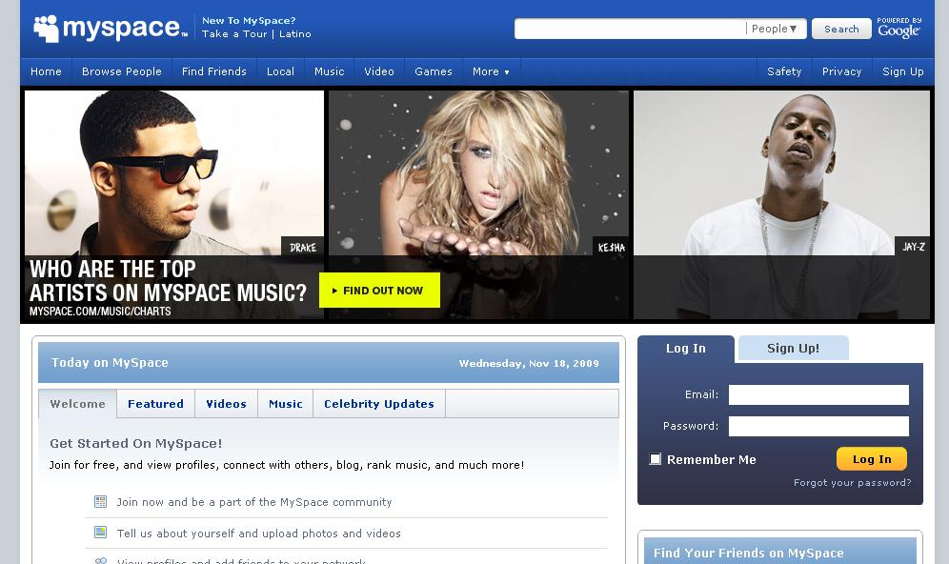
MySpace
Notes:
Myspace is more geared towards hipsters and the pop artist industry
They are displayed right on the front page

Slide 7
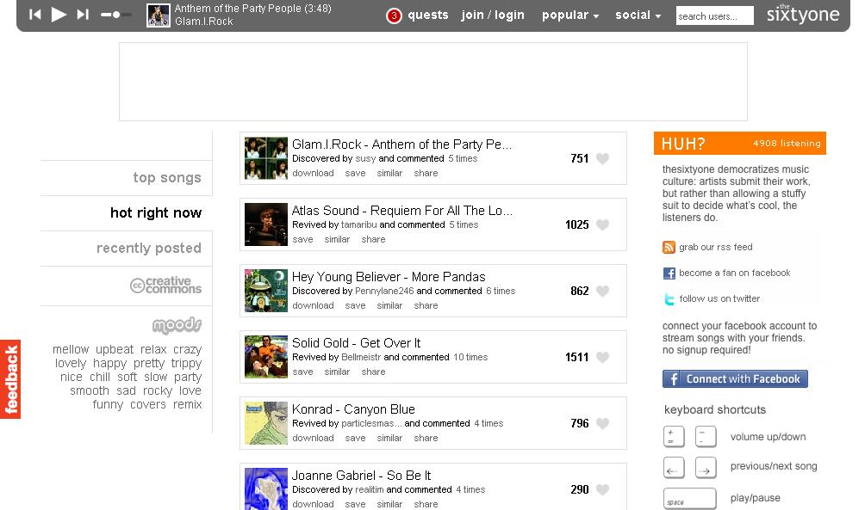
theSixtyOne
Notes:
You can obviously tell it is geared towards music as soon as you get to the page
The player at the top gives it away

Slide 8
Different Types of Social Networking
Professional
Personal
Educational
Development
Lun

Slide 9
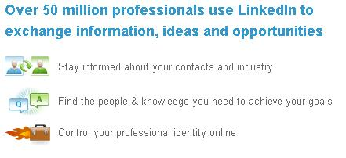
Professional
Provides a way for companies and people to be connected. They can send messages over the LinkedIn network to reach a broader range of people.
  LinkedIn
  Elance
  oDesk
Notes:
Right on the front page LinkedIn advertises the number of businesses and professionals involved
Options to specify a business and connect to that and people through that
Elance and oDesk have the same type of connection options
All of these sites help professional people find the jobs they are looking for

Slide 10
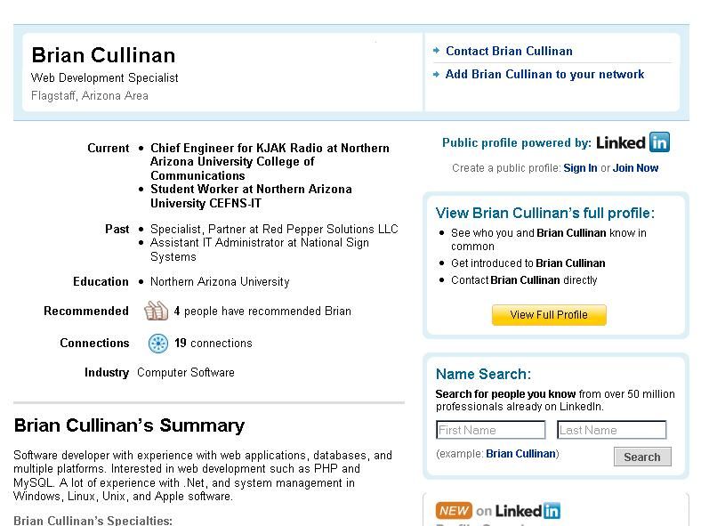
Professional
Looks like
a résumé:

Slide 11
Personal
Provides a way for people to connect to each other on a personal level. You can find and make friends online and communicate with them directly.
  Facebook
  Myspace

Slide 12
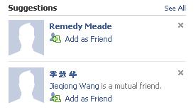

Personal
Very people
oriented:

Slide 13
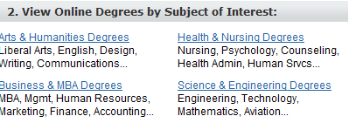
Educational
Collaborating with other students or teachers on academic projects.
  The math Forum
  eLearners

Slide 14

Development
A way for professionals and specialists to connect to team members on projects usually open source
  SourceForge
Lun
Notes:
Another website that I am not allowed to tell people about

Slide 15
Advantages of Social Networking
Free and easy to use
Multiple Messages
Get feedback
Refined Search
Keep in touch
Reach out
Shiqi

Slide 16

Free and Easy to use
See Facebook even says so:

Slide 17
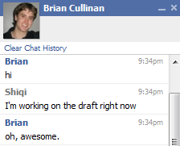
Multiple Messages
Private messages
Instant Messages
Notes:
Still sent to one person but don’t have to disclose actual e-mail

Slide 18
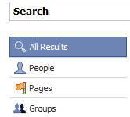
Refined Search
Find people based on the criteria that they share:

Slide 19

Keep in touch
Find friends
Post on walls
Talk to people
Notes:
Facebook suggests people you haven’t communicated with recently.

Slide 20
How to Use Social Networking
Develop a web presence
Choose a media
Sign up
Create your profile
Find people
Profit
Brian

Slide 21


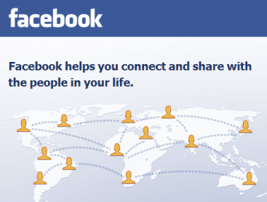

Choose a media
Decide what site to use and why

Slide 22
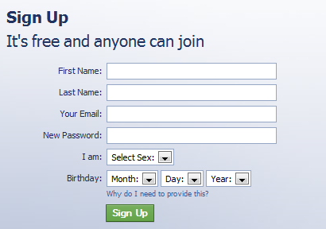
Sign Up
Go to the site and sign up

Slide 23
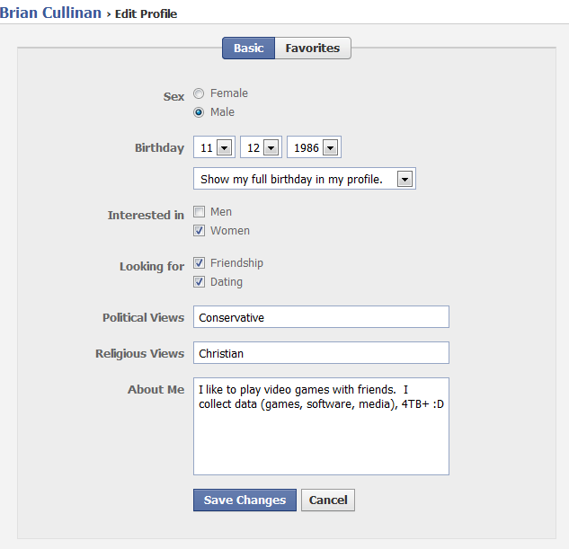
Create your profile
Decide what information you want to make publicly available; that is, always assume it will be public.

Slide 24
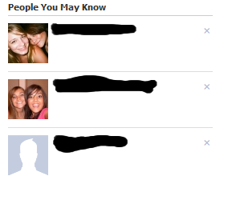
Build your network
Find people

Slide 25
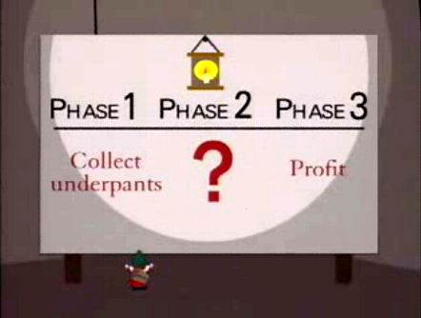
Profit

Slide 26

Conclusion
Social networking has many benefits
Web presence can give you an advantage on the internet
Keep in touch!
Brian

